Slide 1
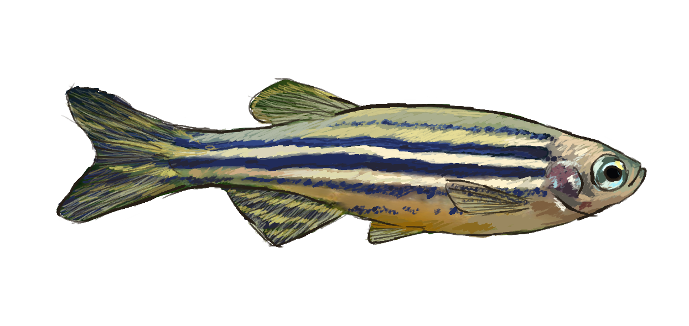
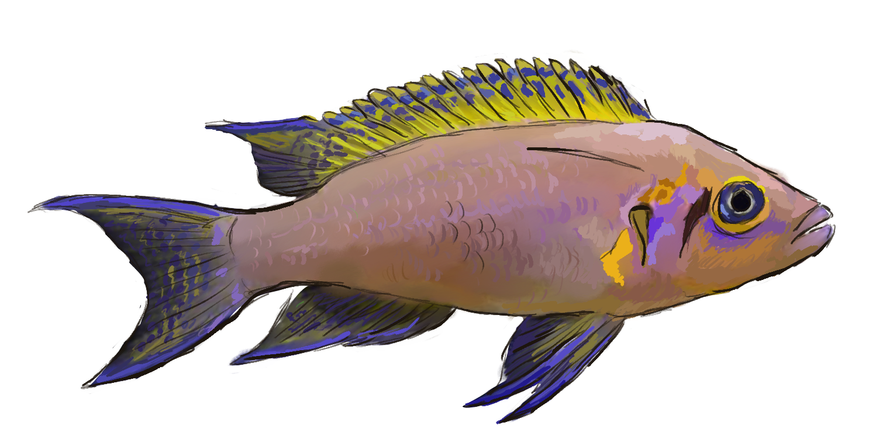
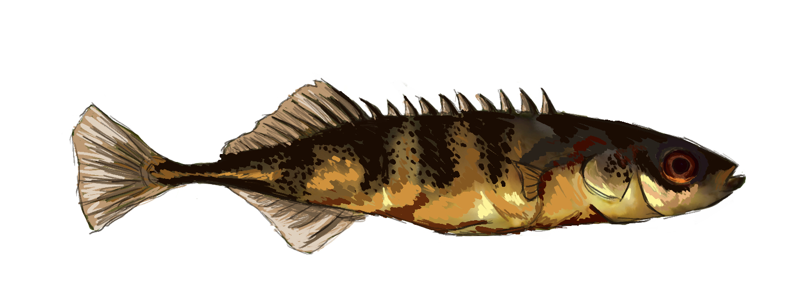
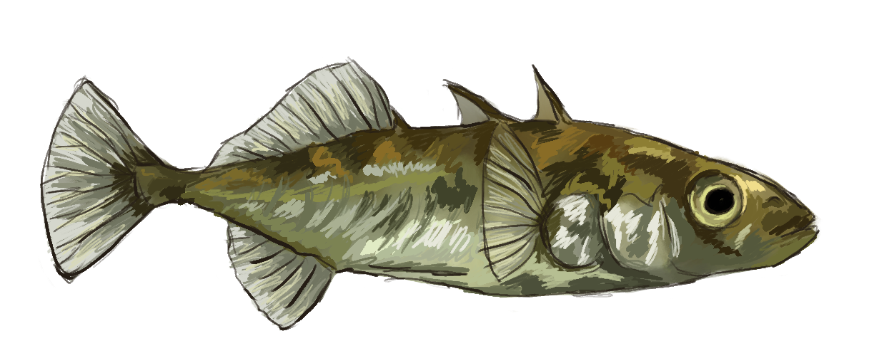
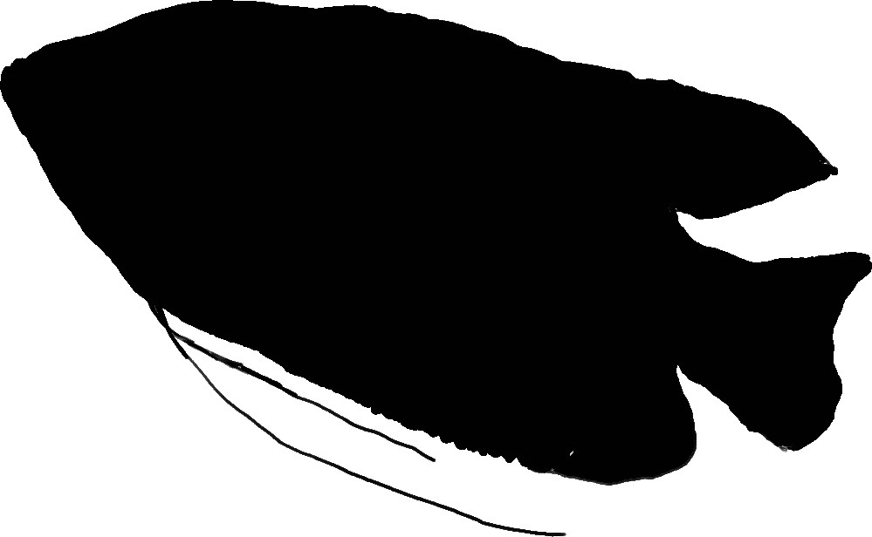
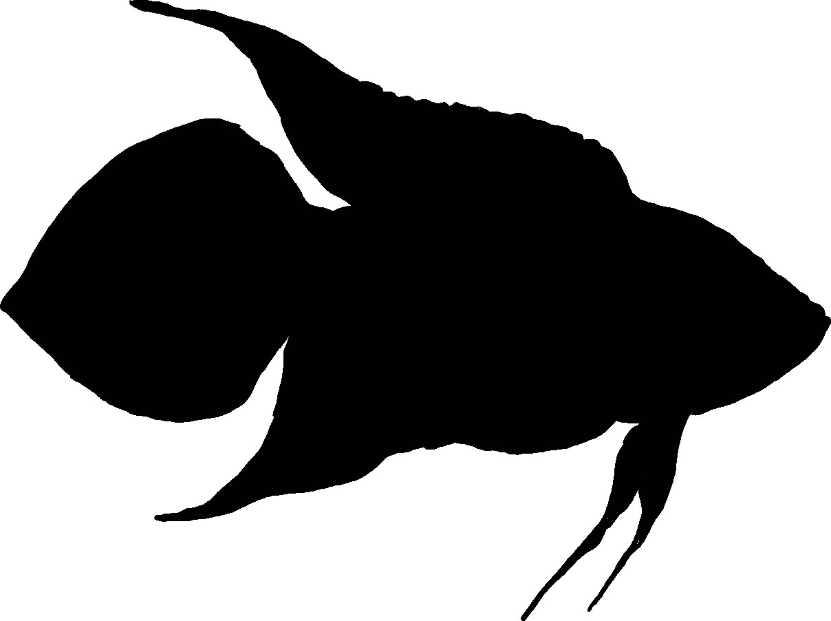
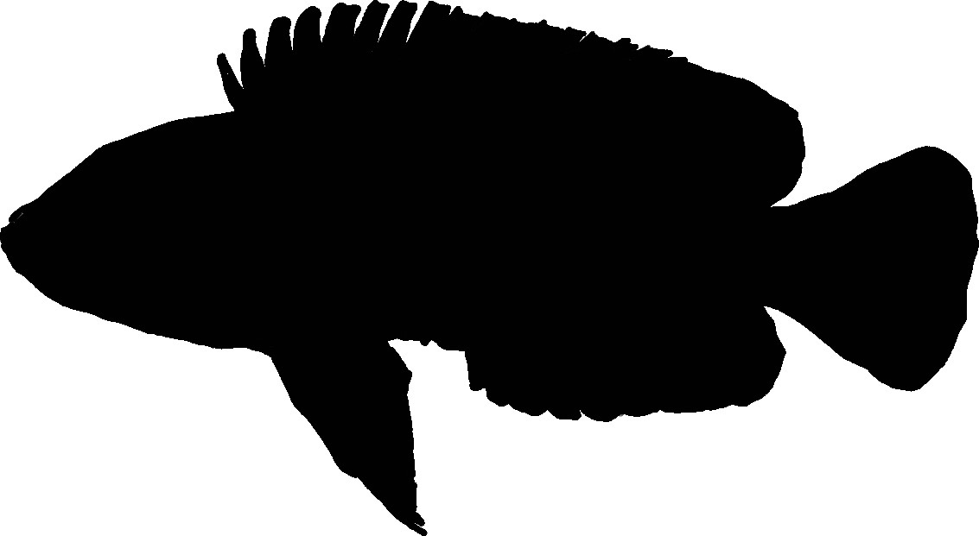
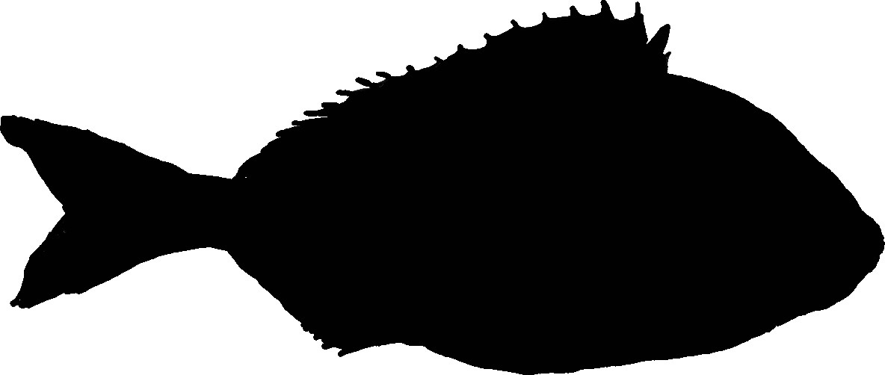


ACCLIMATION IN FISH:
How long should your trials be?
Zebrafish
Danio rerio
Ninespine stickleback
Pungitius pungitius
Camille Troisi¹, Li Veiros², Alahnya Tomlinson^{3,} Susi Zajitschek³, Amelia Munson⁴, Prathik⁵ Jo Frommen⁵, Helen Spence-Jones⁶, Cassandra Scheibl⁷, Nick Jones⁸
Are 10-minute trials enough or are 30-minute trials more likely to achieve acclimation?
Threespine stickleback
Gasterosteus aculeatus
Daffodil cichlid
Neolamprogus pulcher
1
BACKGROUND
2
Methods
For most behavioural and cognitive tests, individuals need to be habituated to the testing conditions before they start behaving normally. What is the optimal duration of acclimation trials, how long should you expect to wait before your chosen model species engages in assays?
There is lots of institutional knowledge, but not much published data to guide researchers in general or for individual species.
We are testing a range of common – and less common – model species in simple open-field behavioural assays across two different lengths of acclimation trials (10 and 30 mins), with individuals tested over three successive days. We measure:
- Latency to start swimming
- Time spent swimming freely
3
Results (so far)
Acclimation Measures (day 3)
4
Take-away
Species
Latency to swim (s)
Time spent actively swimming (%)
There is lots of variation in behaviour between species, and in indicators of acclimation. What works for one species may not be appropriate for another!
5
Next steps
More species!
Trichogaster lalius
Macropodus ocellatus
There are clear species differences in both latency to move and proportion of time spent actively swimming, as well as the effect of longer acclimation lengths. Once we have more species, this project will provide a simple guide to expected acclimation times for many species and a step towards developing optimal length and number of acclimation trials.
Neolamprologus similis
Sparus aurata
Julidochromis sp.
And adding novel object trials on day 4 of testing…
Work with other fishes? Want to join us? Get in touch!
Activity rates over the first 400 seconds of trials for threespine stickleback on successive trial days
camille.troisi@mail.mcgill.ca
narj@st-andrews.ac.uk

